Slide 1
Intro to C++ Part 1

Slide 2
Extensions to C
Data Types
I/O in C++
Typecasting

Slide 3
Extensions to C
much stronger type checking; missing casts that produce warnings in C produce errors in C++
the introduction of true O-O classes
a formal inheritance mechanism in which derived classes can specialize parent classes
formal support for polymorphic behavior in which a derived class may override a base class method simply by providing a method of the same name
support for function overloading in which there may be different implementations with a single function name
an operator overloading mechanism that is analogous to function overloading
the ability to pass parameters by reference in addition to the standard pass by value
yet another input/output library that may be used in addition to standard and low level I/O

Slide 4
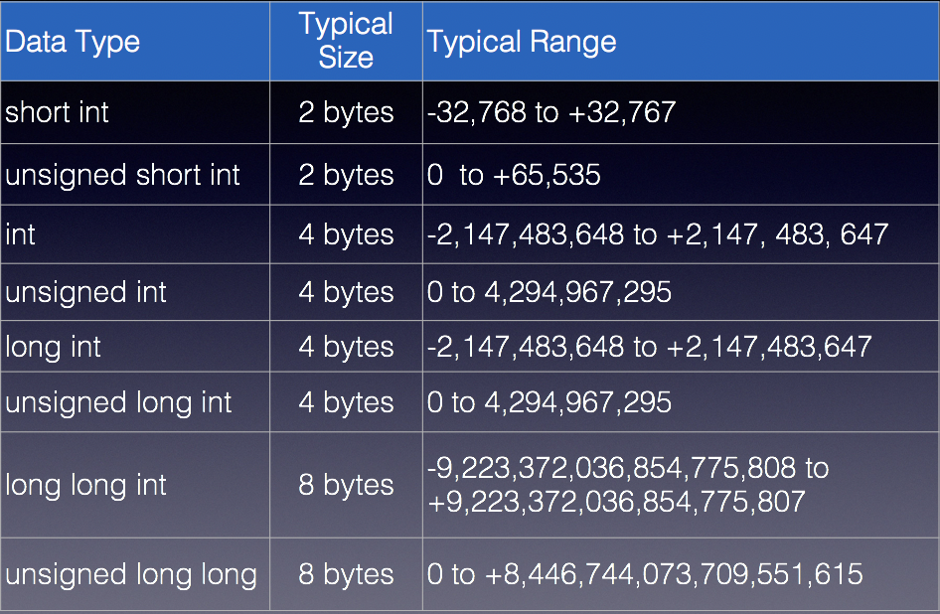
Data Types
Most data types are the same

Slide 5
Data Types – long long since C++11
int checking;
unsigned int miles;
long days; // same as: long int
long long years; // same as: long long int
checking = -20;
miles = 4276;
days = 192000;
years = 59LL; // Some compilers may optimize this since 59 is a small
// number so if your want to guarentee it is 8 bytes,
// the size of a long long you should use LL after 59
// To make sure years is 8 bytes we can check it using the sizeof
cout << endl; cout << "The size of years is: "<< sizeof(years)
<< " bytes" << endl;
cout << "We have made a long journey of " << miles << " miles.";
cout << "\nOur checking account balance is " << checking;
cout << "\nAbout " << days << " days ago Columbus ";
cout << "stood on this spot.\n";
cout << endl;
The size of years is: 8 bytes
We have made a long journey of 4276 miles.
Our checking account balance is -20
About 192000 days ago Columbus stood on this spot.

Slide 6
Data Types – floating point

Slide 7
Data Types – char and string
C++ char is same as C
strings in C are character arrays
In C++, there is a string class which allows us to create a variable of type string. No longer need a character array
#include <string>
string name;
name = “Cathy Hochrine”;

Slide 8
Data Types – auto
C++ introduces an alternative way to define variables by using the auto keyword and an initialization value. The data type is determined by the initialization value.
auto amount = 100; // amount is an int type
auto letter = ‘A’; // letter is a char type
auto customerNum = 456L; // a long int
auto num = amount; /* since amount is an int, so
is num
*/

Slide 9
Data Types – auto
auto test = 10;
auto test2 = "Hello World";
cout << test << endl << test2 << endl;
10
Hello World

Slide 10
Range-Based for Loop
Introduced in C++11
Iterates once for each element in an array
Each time the loop iterates, it copies an element from the array to a variable.
for (dataType rangeVariable:array) {
statements
}

Slide 11
Range-Based for Loop
int arr[5] = {0, 1, 2, 3, 4};
for(auto x: arr) {
if(x != 4)
cout << x << ", ";
else
cout << x;
}
cout << endl;
0, 1, 2, 3, 4

Slide 12
Auto & Range-Based for Loop
On our system, must compile using -std=c++11 flag
g++ -std=c++11 –Wall prog1.cpp

Slide 13
I/O Stream in C++
#include <iostream>
cout (stdout)
cin (stdin)
cerr (stderr)
clog (stderr)
Notes:
cout is a predefined object of the ostream class; corresponds to stdout
cin is a predefined object of the istream class; corresponds to stdin
cerr is a predefined object of the ostream class that represents the standard error stream; corresponds to stderr
cout is a predefined object of the ostream class the represents the standard logging stream; corresponds to stderr

Slide 14
cout
uses the insertion operator
cout << “Hello, I am “ << age << “ years old and my name is “
<< name;
cout << “This is a sentence.”;
cout << “This is another sentence.”;
Notes:
Hello, I am 24 years old and my name is Dave
This is a sentence.This is another sentence.

Slide 15
cout
cout << “This is a sentence.” << endl;
cout << “This is another sentence.”;
cout << “This is a sentence. \n”;
cout << “This is another sentence.”;
cout << “This is a sentence.” << endl << “This is another sentence.”;
NOTE: endl; forces anything left in a buffer to be flushed from the stream; for more info on stream buffering, see:
http://www.gnu.org/software/libc/manual/html_node/Stream-Buffering.html
Notes:
All three of those:
This is a sentence.
This is another sentence.

Slide 16
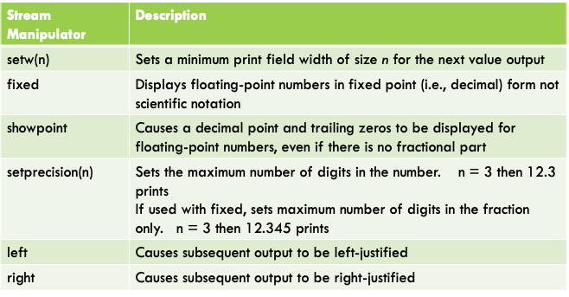
cout – formatting output
Notes:
All three of those:
This is a sentence.
This is another sentence.

Slide 17
Formatted output with setw()
int num1 = 2897, num2 = 5, num3 = 837,
num4 = 34, num5 = 7, num6 = 1623,
num7 = 390, num8 = 3546, num9 = 12;
cout << endl << "unformatted output:" << endl;
cout << num1 << " " << num2 << " " << num3 << endl;
cout << num4 << " " << num5 << " " << num6 << endl;
cout << num7 << " " << num8 << " " << num9 << endl;
cout << endl << "formatted output with setw(6), right justified:”
<< endl;
cout << setw(6) << num1 << setw(6) << num2 << setw(6) << num3
<< endl;
cout << setw(6) << num4 << setw(6) << num5 << setw(6) << num6
<< endl;
cout << setw(6) << num7 << setw(6) << num8 << setw(6) << num9
<< endl;
cout << endl;
unformatted output:
2897 5 837
34 7 1623
390 3546 12
formatted output with setw(6), right justified:
2897 5 837
34 7 1623
390 3546 12

Slide 18
Formatted output with setprecision()
double num1 = 132.364, num2 = 26.91;
double quotient = num1 / num2;
cout << endl << endl;
// no precision set, default is 6
cout << "no precision set; default is 6" << endl;
cout << quotient << endl;
cout << endl;
cout << "setprecision(5)" << endl;
cout << setprecision(5) << quotient << endl << endl;
cout << "seeing that it is still 5" << endl
<< quotient << endl;
cout << endl;
cout << "setprecision(6), back to default" << endl;
cout << setprecision(6) << quotient << endl;
no precision set, default is 6
4.91877
setprecision(5)
4.9188
seeing that it is still 5
4.9188
setprecision(6), back to default
4.91877

Slide 19
Formatted output with setprecision() & fixed
double num1 = 132.364, num2 = 26.91;
double quotient = num1 / num2;
cout << endl<< "no precision set, default is 6”;
cout << endl<< quotient << endl << endl;
cout << "precision set to 4, 3, 2, and 1" << endl;
cout << setprecision(4) << quotient << endl;
cout << setprecision(3) << quotient << endl;
cout << setprecision(2) << quotient << endl;
cout << setprecision(1) << quotient << endl;
cout << endl;
cout << "setprecision(6), back to default" << endl;
cout << setprecision(6) << quotient << endl << endl;
cout << "setprecision(4) without fixed " << endl;
cout << setprecision(4) << quotient << endl;
cout << endl;
cout << "setprecision(4) with fixed" << endl;
cout << fixed << setprecision(4) << quotient << endl;
cout << endl;
no precision set, default is 6
4.91877
precision set to 4, 3, 2, and 1
4.919
4.92
4.9
5
setprecision(6), back to default
4.91877
setprecision(4) without fixed
4.919
setprecision(4) with fixed
4.9188

Slide 20
Formatted output with setprecision() & fixed
double num1 = 132.364, num2 = 26.91;
double quotient = num1 / num2;
cout << "setprecision(6), back to default";
cout << " notice fixed is still set" << endl;
cout << setprecision(6) << quotient << endl << endl;
cout << endl;
setprecision(6), back to default notice fixed is still set
4.918766

Slide 21
Formatted output with showpoint
double num1 = 132.0;
cout << endl << endl << "num1 is: " << num1;
cout << endl << endl;
cout << "num1 with showpoint is: " << showpoint << num1;
cout << endl << endl << "num1 without showpoint is: " << num1 << endl;
cout << "notice showpoint is still set";
cout << endl << endl;
cout << "num1 with noshowpoint is: " << noshowpoint << num1;
num1 is: 132
num1 with showpoint is: 132.000
num1 without showpoint is: 132.000
notice showpoint is still set
num1 with noshowpoint is: 132
Notes:
showpoint, fixed and setprecision can be used together

Slide 22
cin
uses the extraction operator
int age;
cin >> age;
int a, b;
cin >> a >> b;
Notes:
cin >> a >> b; is equivalent to:
cin >> a;
cin >> b;

Slide 23
cin
string name;
cout << “What is your name?” << endl;
cin >> name;
Notes:
cin stops reading as soon as it finds any blank space character, so…

Slide 24
cin
#include <iostream>
#include <string>
using namespace std;
int main( void ) {
string name;
cout << “What is your full name?” << endl;
getline( cin, name );
cout << “Hello “ << name << “.\n”;
return 0;
}
Notes:
… if wanting more than one string from the command line, use getline()

Slide 25
cerr and clog
cerr writes unbuffered output to stdout (unbuffered are written as soon as the characters are encountered)
clog write uses buffered output (buffered streams are written only when the buffer is filled, or as with line buffered streams, as soon as the newline character is encountered)

Slide 26
Typecasting
C - style type casting
double num = 3.7;
int val;
val = (int) num;
C++ - style type casting
val = static_cast <int>(num);
Pre-standard C++ style type casting
val = int (num);
The static_cast form is the ANSI
(American National Standard Institute)
standard now. However, you may see
C-style or pre-standard style being used
in old code.
For this class we will use the C++ style
type casting.

